Slide 1
More about CSS Style Rules
Advanced Display Techniques
Non-HTML documents & Printer-friendly pages
COMP 105

Slide 2
Advanced Layout topics
Creating columns using CSS
A photoblog

Slide 3
Creating columns
We begin by defining four basic divisions:
    header: this will serve as a header to the document; in the end it’ll span across the page occupying 90% of browser window width.
    lcol: this will (eventually) serve as a left column in a “main content” division
    rcol: this will (eventually) serve as a right column in a “main content” division
    footer: this will serve as a footer to the document; in the end it’ll span across the page occupying 90% of the browser window width.
Each of the sections is “color-coded” so you can easily see where they appear in the browser.

Slide 4
Round 1 (scratchy1a.html)
In the first example, we show that defining the four aforementioned divisions simply follow the normal block layout, i.e., stacked vertically in the browser window.
<html>
<head>
<style>
#header{background-color:pink;}
#lcol{background-color:green;}
#rcol{background-color:blue;}
#footer{background-color:black;}
</style>
<title>Round 1</title>
</head>
<body bgcolor="yellow">
<!-- begin header -->
<div id="header">
<p>This is the header...</p>
</div>
<!-- end header -->
<!-- begin lcol -->
<div id="lcol">
<p>This is the left column...</p>
</div>
<!-- end lcol -->
<!-- begin rcol -->
<div id="rcol">
<p>This is the right column...</p>
</div>
<!-- end rcol -->
<!-- begin footer -->
<div id="footer">
<p style="color:#FFFF00">This is the footer...</p>
</div>
<!-- end footer -->
</body>
</html>

Slide 5
Round 2 (scratchy1b.html)
In this next example, we encapsulate the four aforementioned divisions in a container division called wrap. This is how we “shrink” the content to span 90% of the browser window width.
<body bgcolor="yellow">
<!-- padding: top, right, bottom, left -->
<!-- begin wrap -->
<div id="wrap">
<!-- begin header -->
<div id="header">
<p>This is the header...</p>
</div>
<!-- end header -->
<!-- begin lcol -->
<div id="lcol">
<p>This is the left column...</p>
</div>
<!-- end lcol -->
<!-- begin rcol -->
<div id="rcol">
<p>This is the right column...</p>
</div>
<!-- end rcol -->
<!-- begin footer -->
<div id="footer">
<p style="color:#FFFF00">This is the footer...</p>
</div>
<!-- end footer -->
</div>
<!-- end wrap -->
</body>
</html>
<html>
<head>
<meta http-equiv="Content-Type" content="text/html; charset=utf-8" />
<style>
#wrap{width:90%; margin:20px auto; padding:5px 5px 5px 5px; background-color:white;}
#header{background-color:pink;}
#lcol{background-color:green;}
#rcol{background-color:blue;}
#footer{background-color:black;}
</style>
<title>Round 2</title>
</head>

Slide 6
Round 3 (scratchy1c.html)
In this example, we encapsulate the lcol and rcol divisions in a division entitled “maincontent”. This will serve as the basis of the two columns in the next example.
<body bgcolor="yellow">
<!-- padding: top, right, bottom, left -->
<!-- begin wrap -->
<div id="wrap">
<!-- begin header -->
<div id="header">
<p>This is the header...</p>
</div>
<!-- end header -->
<!-- begin maincontent -->
<div id="maincontent">
<!-- begin lcol -->
<div id="lcol">
<p>This is the left column...</p>
</div>
<!-- end lcol -->
<!-- begin rcol -->
<div id="rcol">
<p>This is the right column...</p>
</div>
<!-- end rcol -->
</div>
<!-- end maincontent -->
<!-- begin footer -->
<div id="footer">
<p style="color:#FFFF00">This is the footer...</p>
</div>
<!-- end footer --></div><!-- end wrap --></body></html>
<html>
<head>
<meta http-equiv="Content-Type" content="text/html; charset=utf-8" />
<style>
#wrap{width:90%; margin:20px auto; padding:5px 5px 5px 5px; background-color:white;}
#header{background-color:pink;}
#maincontent{background-color:olive;}
#lcol{background-color:green;}
#rcol{background-color:blue;}
#footer{background-color:black;}
</style>
<title>Round 3</title>
</head>

Slide 7
Round 4 (scratchy2.html)
In this final example, we make lcol and rcol to appear side-by-side, giving the illusion of a two-column content area. Noteworthy in this example are the following:
    The body of scratchy1c.html and scratch2.html are nearly identical; they differ by only one line; a line that contains <br clear=”all” />
    To this end, you should be enlightened as to how the “same” code can appear so drastically different. How? Take a look at the <style> </style> section in the <head>…</head> region of scratchy2.html and how it differs from scratchy1c.html.
    Note the use of <br clear=”all” /> to keep the maincontent divisions from overflowing into the footer section.

Slide 8
Round 4 (scratchy2.html)
In this final example, we make lcol and rcol to appear side-by-side, giving the illusion of a two-column content area.
<body bgcolor="yellow">
<!-- padding: top, right, bottom, left -->
<!-- begin wrap -->
<div id="wrap">
<!-- begin header -->
<div id="header">
<p>This is the header...</p>
</div>
<!-- end header -->
<!-- begin maincontent -->
<div id="maincontent">
<!-- begin lcol -->
<div id="lcol">
<p>This is the left column...</p>
</div>
<!-- end lcol -->
<!-- begin rcol -->
<div id="rcol">
<p>This is the right column...</p>
</div>
<!-- end rcol -->
</div>
<!-- end maincontent -->
<!-- begin footer -->
<div id="footer">
<p style="color:#FFFF00">This is the footer...</p>
</div>
<!-- end footer --></div><!-- end wrap --></body></html>
<html>
<head>
<meta http-equiv="Content-Type" content="text/html; charset=utf-8" />
<style>
#wrap{width:90%; margin:20px auto; padding:5px 5px 5px 5px; background-color:white;}
#header{background-color:pink;}
#maincontent{background-color:olive;}
#lcol{background-color:green; float:left; width:50%;}
#rcol{background-color:blue; float:right; width:50%;}
#footer{background-color:black;}
</style>
<title>Round 4</title>
</head>
The body does not change!

Slide 9
Round 5 (scratchy2b.html)
In this extension we just provide a little formatting to make the page look better.
    The text in the header is centered and the header size is shrunk to 25% of the width of the browser page. Note how we center the header: by setting the margin-left and the margin-right to auto. This is the same technique that we used with tables.
    We format the footer in the same manner.

Slide 10
Round 5 (scratchy2b.html)
In this extension we just provide a little formatting to make the page look better.
<body bgcolor="yellow">
<!-- padding: top, right, bottom, left -->
<!-- begin wrap -->
<div id="wrap">
<!-- begin header -->
<div id="header">
<p>This is the header...</p>
</div>
<!-- end header -->
<!-- begin maincontent -->
<div id="maincontent">
<!-- begin lcol -->
<div id="lcol">
<p>This is the left column...</p>
</div>
<!-- end lcol -->
<!-- begin rcol -->
<div id="rcol">
<p>This is the right column...</p>
</div>
<!-- end rcol -->
</div>
<!-- end maincontent -->
<!-- begin footer -->
<div id="footer">
<p style="color:#FFFF00">This is the footer...</p>
</div>
<!-- end footer --></div><!-- end wrap --></body></html>
<html><head>
<style>
#wrap{width:90%; margin:20px auto; padding:5px 5px 5px 5px; background-color:white;}
#header{background-color:pink; text-align: center;
width:25%;
margin-left:auto;
margin-right:auto}
#maincontent{background-color:olive; }
#lcol{background-color:green; float:left; width:50%;}
#rcol{background-color:blue; float:right; width:50%;}
#footer{background-color:black; text-align:center;
width:25%;
margin-left:auto;
margin-right:auto}
</style>
<title>Round 5</title></head>
The body does not change!

Slide 11
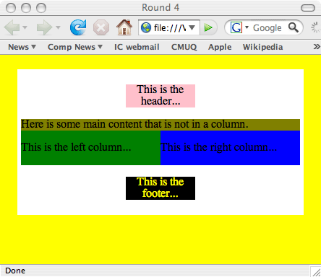
Final result

Slide 12
Caution! Watch for margins!!
<body bgcolor="yellow">
<!-- padding: top, right, bottom, left -->
<!-- begin wrap -->
<div id="wrap">
<!-- begin header -->
<div id="header">
<p>This is the header...</p>
</div>
<!-- end header -->
<!-- begin maincontent -->
<div id="maincontent">
<!-- begin lcol -->
<div id="lcol">
<p>This is the left column...</p>
</div>
<!-- end lcol -->
<!-- begin rcol -->
<div id="rcol">
<p>This is the right column...</p>
</div>
<!-- end rcol -->
</div>
<!-- end maincontent -->
<!-- begin footer -->
<div id="footer">
<p style="color:#FFFF00">This is the footer...</p>
</div>
<!-- end footer --></div><!-- end wrap --></body></html>
<html><head>
<style>
#wrap{width:90%; margin:20px auto; padding:5px 5px 5px 5px; background-color:white;}
#header{background-color:pink; text-align: center;
width:25%;
margin-left:auto;
margin-right:auto}
#maincontent{background-color:olive; }
#lcol{background-color:green; float:left; width:50%; margin-right:30px}
#rcol{background-color:blue; float:right; width:50%;}
#footer{background-color:black; text-align:center;
width:25%;
margin-left:auto;
margin-right:auto}
</style>
<title>Round 5</title></head>

Slide 13
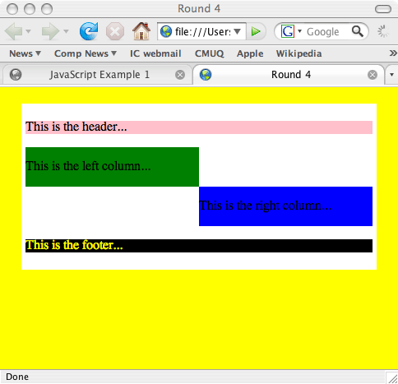
The margin-right produces this error
Offset column!

Slide 14
A sophisticated example
DivStructure2.html
  Demonstrates sophisticated CSS layout
A photoblog
  Note meaningful names for div blocks
    header
    main
      entry
      sidebar
      footer
  Comments are used to note the end of a div block (helps with keeping the div sections straight)

Slide 15
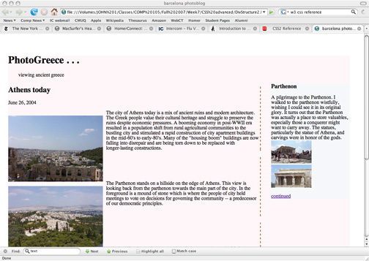
divStruct2.html
Colored background with width set to 95% of browser window
On the left side of the browser window with width set to 74% of browser window
Main window flush on the right side of the browser window.
Sidebar on left side of window
Photos to the left of the main window.
Colored border to the rigth of each entry

Slide 16
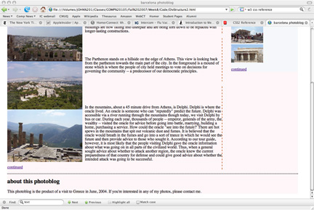
divStruct2.html
Footer has a dotted border on the top and does not wrap around the main page

Slide 17
Style rules
<style>
#screen {background:#FEF6F8;}
#sidebar {background:#F5F8FA; margin-left:77%}
#wrap {width: 95%; margin: 20px auto; padding: 30px 20px 0 0;}
#main {width: 74%; float:left}
.description {position:relative; left: 2em; margin-bottom: 0.5em;}
.continued { clear:both;}
.entry {border-right: 2px dashed #B74E07;}
.photo_text {margin-left:310px; }
.photo_text {position:relative;}
.photo {position:absolute; left:-310px; }
#header {font-family:Ariel;}
#footer {clear:both; border-top:2px dotted;}
</style>

Slide 18
Creating the main page
<style>
#screen {background:#FEF6F8;}
#sidebar {background:#F5F8FA; margin-left:77%}
#wrap {width: 95%; margin: 20px auto; padding: 30px}
#main {width: 74%; float:left}
.description {position:relative; left: 2em; margin-bottom: 0.5em;}
.continued {clear:both;}
.entry {border-right: 2px dashed #B74E07;}
.photo_text {margin-left:310px; }
.photo_text {position:relative;}
.photo {position:absolute; left:-310px; }
#header {font-family:Ariel;}
#footer {clear:both; border-top:2px dotted;}
</style>
<body>
<div id="wrap">
<div id="screen">
<div id="header">
<h1>PhotoGreece . . .</h1>
<p class="description">viewing ancient
greece</p>
</div> <!-- end #header -->
<div id="main">

Slide 19
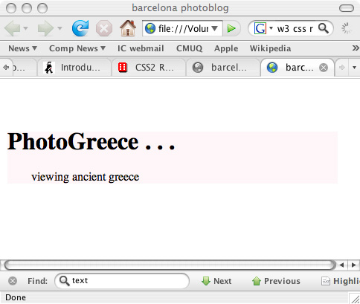
Creating the main page
#screen {background:#FEF6F8;}
#wrap {width: 95%; margin: 20px auto; padding: 30px}
Sets up the outer box: colored background with width set to 95% of browser window
.description {position:relative; left: 2em; margin-bottom: 0.5em;}
Makes the description indented relative to its enclosing box and slightly below the header

Slide 20
DivStructure2.html
Floating elements in CSS
Boxes can be made to float on the web page
  Useful for sidebars
  Can be used to create multi-column layouts without tables ("table-less" web pages)
  #main {width: 74%; float:left}
  In this example, it is the main div box that is floating, not the sidebar!

Slide 21
Creating the entries
#main {width: 74%; float:left}
the set containing all of the entries will be smaller than the outer (colored) box and will float to the left side of the box.
<div id="main">
<div class="entry">
<h2>Athens today</h2>
<p class="date">June 26, 2004</p>
<div class="photo_text">
<p class="photo"><img src="../images/athens1.jpg" width="300"
height="210" alt="athens1.JPG" /></a></p>
<p>The city of Athens today is a mix of ancient ruins and modern …
  Lots of descriptive text follows...
  </p>
</div><!-- end .photo_text -->
</div> <!-- end .entry -->
.entry {border-right: 2px dashed #B74E07;}
Each entry will have a colored border on it’s right.
.photo_text {margin-left:310px; }
.photo_text {position:relative;}
The photo writing (text) will be indented because it’s left margin is 310 pixels relative to the box that it’s inside of (the entry div box)
.photo {position:absolute; left:-310px; }
But the photo itself should be at the left margin, so we’ll set it’s margin at a negative 310 pixels.

Slide 22
DivStructure2.html
Positioning a box in an absolute location in the window is called absolute positioning.
  .photo_text {position:relative;}
  .photo {position:absolute; left:-310px; }
  Notes:
  1) First, the photo_text class position is set to relative.
  2) This allows photos to be positioned with respect to it (and not to the body).
  3) The negative left offset pulls the photo to the left and out of the photo_text box, allowing the text to remain on the right.

Slide 23
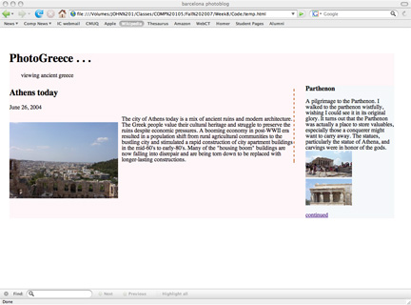
Creating the entries
#main {width: 74%; float:left}
the set containing all of the entries will be smaller than the outer (colored) box and will float to the left side of the box.
.entry {border-right: 2px dashed #B74E07;}
Each entry will have a colored border on it’s right.
.photo_text {margin-left:310px; }
.photo_text {position:relative;}
The photo writing (text) will be indented because it’s left margin is 310 pixels relative to the box that it’s inside of (the entry div box)
.photo {position:absolute; left:-310px; }
But the photo itself should be at the left margin, so we’ll set it’s margin at a negative 310 pixels. Since it is relative it will be 310 pixels to the left of the .photo_text div box.

Slide 24
Creating the sidebar
#sidebar {background:#F5F8FA; margin-left:77%}
change the background color and set the left margin to be 77% of the enclosing box.
<div id="sidebar">
<h3>Parthenon</h3>
<p>A pilgrimage to the Parthenon. Lots more text follow...
<br /><img src="../images/Parthenon1.jpg" width="128" height="73" alt="Parthenon1.jpg" />
<br /><img src="../images/Parthenon2.jpg" width="128" height="73" alt="Parthenon2.jpg" />
</p>
<p class="continued"><a href="">continued</a></p>
</div> <!-- end #sidebar -->
.continued {clear:both}
Link must occur after the picture and text.

Slide 25
Creating the sidebar
#sidebar {background:#F5F8FA; margin-left:77%}
change the background color and set the left margin to be 77% of the enclosing box.
(recall that the div box to the right was 74% of the enclosing box)
.continued {clear:both}
Link must occur after the picture and text.

Slide 26
Creating the footer
<div id="footer">
<h2>about this photoblog</h2>
<p>This photoblog is the product of a visit to Greece in June, 2004.
If you're interested in any of my photos, please contact me. </p>
</div> <!-- end #footer -->
#footer {clear:both; border-top:2px dotted;} clear so that the footer does not float to the right of the main window. Put a border on the top of the footer.

Slide 27
divStruct2.html
#footer {clear:both; border-top:2px dotted;} clear so that the footer does not float to the right of the main window. Put a border on the top of the footer.

